Slide 1

MILESTONE- 3
CLASS : DATA MANAGEMENT FOR ANALYTICS
SECTION : 4
SUBMITTED BY : TEJAS RAUT & MAHIM MITTAL
GROUP : 4
SUBMITTED TO : PROF. VENKAT KRISHNAMURTHY

Slide 2

PROBLEM DEFINITION
We are consulting a B->C, Beauty Product Company in order to increase their annual sales for 2024. Our major contribution will be from the monthly data of 9 business entities we identified with their relationship to each other. The data from each entity will lead us to optimizing their production cost and volume of certain products, identified by PROD_ID. Using customer, order entities and product quantity ordered we will be able to maximize customer satisfaction. Also, we will identify the maximum product sold and try to optimize the production quantity of top 5 products sold.

Slide 3
PROBLEM DEFINITION
The company is identified by a unique name and has location, web site, and contact. The company has multiple products identified by a unique Product ID and has product name and product type. The company has multiple customers who are identified by a unique customer ID and has their name, phone, and email. A customer must be either an online or a retail customer. An online customer places an online order which is identified by a unique order number and has amount, and to address details. An online order is facilitated by the company. A retail customer places an order which is identified by a unique order number and has amount details. A retail order is facilitated by the store. The company has multiple stores which are uniquely identified by store ID and has location details. An online order generates a bill with a unique bill number and has its total amount, and payment type. Similarly, A retail order generates a bill with a unique bill number and has its total amount, and payment type. The online orders are carried by their delivery partner identified by a unique delivery partner number and has their name and contact details.

Slide 4
Age
O_Bill_no
Total_Amount
Cust_id
Name
Pays
1..1
Online_Bill
Generates
1..1
Customer
O_Ord_no
Cust_Type
Payment_Type
T
Phone
1..1
o
0..M
Online_Order
Amount
Places
Delivers
1..1
0..M
1..1
To_Address
Retail_Customer
Pays
1..1
Dp_id
1..1
Online_Customer
1..1
1..1
Delivery_Partner
Facilitates
Name
Places
Total_Amount
Qnty
R_Ord_no
Phone
Location
0..M
Is employed by
1..1
Retail_Bill
C_Name
Retail_Order
Generates
1..1
1..1
1..1
1..1
Company
Prod_Name
0..M
R_Bill_no
1..1
Amount
1..1
Produces
1..M
Web_Site
Product
1..1
Contact
1..M
Is facilitated by
Store
1..M
Prod_id
1..M
Prod_Type
Location
Store_id
Facilitates

Slide 5
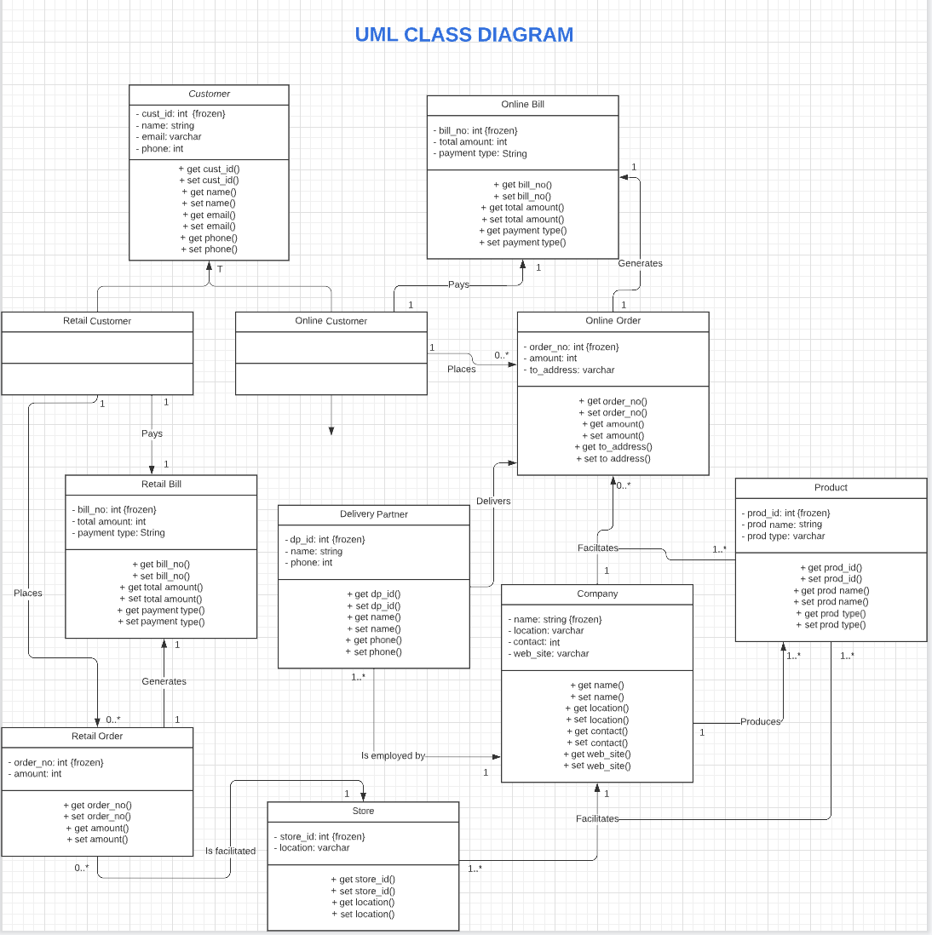
UML

Slide 6

NORMALIZED DATA MODEL – 3.5NF
NOTE: All primary keys are underlined AND all foreign keys are in Italics
Product (Prod_id, Prod_Name, Prod_Type, C_Name)
Customer (Cust_id, Age, Name , Phone, Cust_Type)
Online_Bill (O_Bill_no, Total_Amount, Payment_Type, Cust_id, O_Ord_no)
Online_Order (O_Ord_no, Amount, Cust_id, Dp_id, C_Name)
Retail_Bill (R_Bill_no, Total_Amount, Cust_id, R_Ord_no)
Retail_Order (R_Ord_no, Amount, Cust_id, Store_id)
Online_Order_Facilitates (O_Ord_no, Prod_id, C_Name, Qnty)
Delivery_Partner (Dp_id, Name, Phone, C_Name)
Company (C_Name, Location, Contact, Web_Site)
Retail_Customer (Cust_id, Email, Name , Phone, Store_id)
Store (Store_id, Location, C_Name)
Retail_Store_Facilitates (Store_id, Prod_id, C_Name)

Slide 7
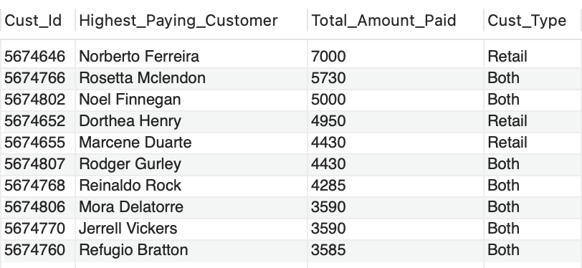
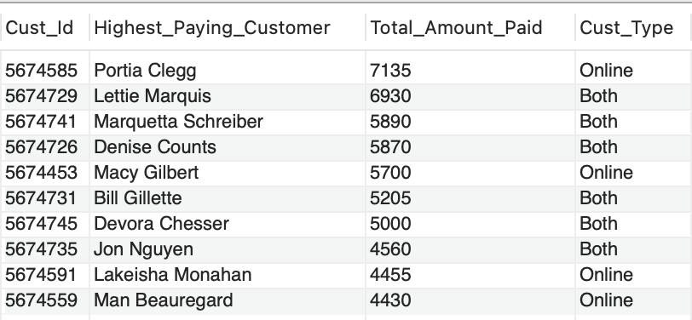
# QUERY_1 - FETCH DATA FOR TOP 10 HIGHEST PAYING ONLINE CUSTOMER WITH TOTAL AMOUNT SPENT SELECT DISTINCT(Customer.Cust_Id), Customer.Name AS Highest_Paying_Customer, SUM(Online_Order.Amount) As Total_Amount_Paid, Customer.Cust_Type FROM Online_Order INNER JOIN Customer ON Online_Order.Cust_id = Customer.Cust_id GROUP BY Customer.Cust_id, Customer.Name ORDER BY SUM(Online_Order.Amount) DESC limit 10;
# QUERY_2 - FETCH DATA FOR TOP 10 HIGHEST PAYING RETAIL CUSTOMER WITH TOTAL AMOUNT SPENT SELECT DISTINCT(Customer.Cust_Id), Customer.Name AS Highest_Paying_Customer, SUM(Retail_Order.Amount) As Total_Amount_Paid, Customer.Cust_Type FROM Retail_Order INNER JOIN Customer ON Retail_Order.Cust_id = Customer.Cust_id GROUP BY Customer.Cust_id, Customer.Name ORDER BY SUM(Retail_Order.Amount) DESC limit 10;

Slide 8
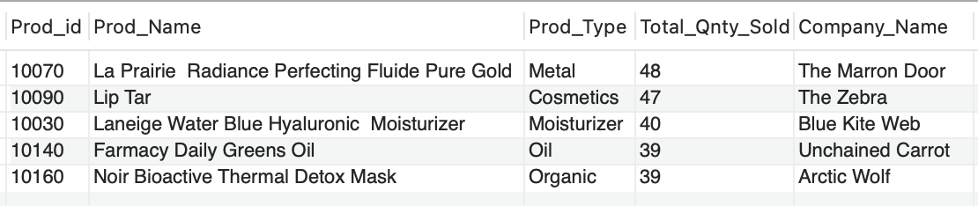
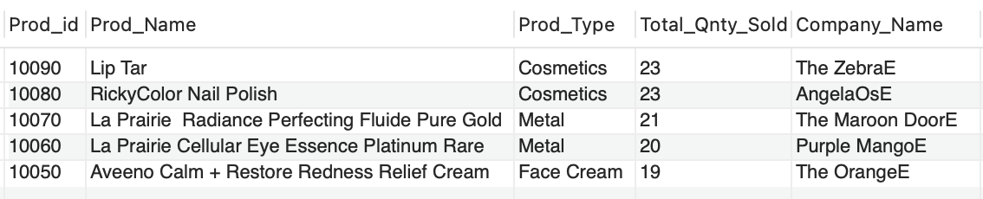
# QUERY_3 - FETCH DATA FOR TOP 5 SOLD PRODUCTS ONLINE SELECT DISTINCT(Online_Order_Facilitates.Prod_id), Product.Prod_Name, Product.Prod_Type, Sum(Online_Order_Facilitates.Qnty) As Total_Qnty_Sold, Online_Order_Facilitates.C_Name AS Company_Name FROM Online_Order_Facilitates INNER JOIN Product ON Online_Order_Facilitates.Prod_id = Product.Prod_id GROUP BY Prod_id, Company_Name ORDER BY Sum(Online_Order_Facilitates.Qnty) DESC limit 5;
# QUERY_4 - FETCH DATA FOR TOP 5 SOLD PRODUCTS IN RETAIL SELECT DISTINCT(Retail_Store_Facilitates.Prod_id), Product.Prod_Name, Product.Prod_Type, Sum(Retail_Store_Facilitates.Qnty) As Total_Qnty_Sold, Retail_Store_Facilitates.C_Name AS Company_Name FROM Retail_Store_Facilitates INNER JOIN Product ON Retail_Store_Facilitates.Prod_id = Product.Prod_id GROUP BY Prod_id, Company_Name ORDER BY Sum(Retail_Store_Facilitates.Qnty) DESC limit 5;

Slide 9
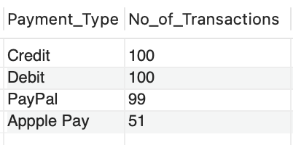
# QUERY_5 - FETCH DATA FOR MOST USED METHOD FOR ONLINE MONEY TRANSACTIONS SELECT DISTINCT(Payment_Type), COUNT(Payment_Type) AS No_of_Transactions FROM Online_Bill GROUP BY Payment_Type ORDER BY COUNT(Payment_Type) DESC;

Slide 10
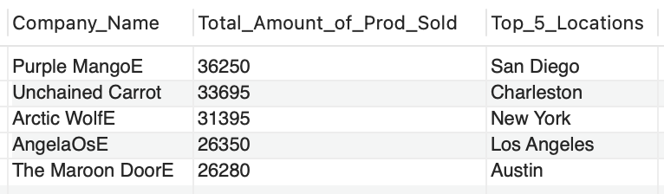
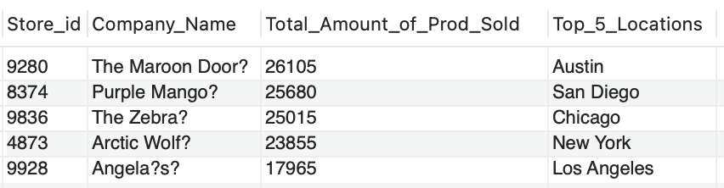
# QUERY_6 - FETCH DATA FOR TOP 5 POTENTIAL BUSINESS LOCATIONS FOR ONLINE CUSTOMERS SELECT DISTINCT(Online_Order.C_Name) AS Company_Name, SUM(Online_Order.Amount) AS Total_Amount_of_Prod_Sold, Company.Location AS Top_5_Locations FROM Online_Order JOIN Company ON Online_Order.C_Name = Company.C_Name GROUP BY Location, Company_Name ORDER BY SUM(Online_Order.Amount) DESC limit 5;
# QUERY_7 - FETCH DATA FOR TOP 5 POTENTIAL BUSINESS LOCATIONS FOR RETAIL CUSTOMERS SELECT DISTINCT(Retail_Order.Store_id) AS Store_id, Store.C_Name AS Company_Name, SUM(Retail_Order.Amount) AS Total_Amount_of_Prod_Sold, Store.Location AS Top_5_Locations FROM Retail_Order JOIN Store ON Retail_Order.Store_id = Store.Store_id GROUP BY Location, Company_Name, Store_id ORDER BY SUM(Retail_Order.Amount) DESC limit 5;

Slide 11
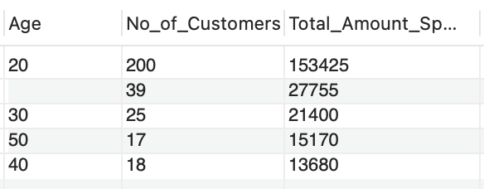
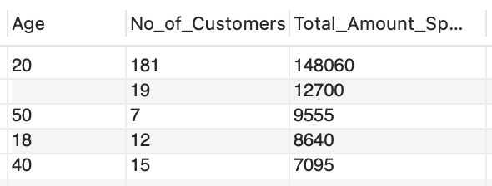
# QUERY_8 - FETCH DATA FOR TOP 5 TARGET AGE GROUPS FOR ONLINE CUSTOMERS ACCORDING TO TOTAL AMOUNT SPENT BY THEM SELECT DISTINCT(Customer.Age), COUNT(Customer.Age) AS No_of_Customers, SUM(Online_Order.Amount) AS Total_Amount_Spent FROM Online_Order INNER JOIN Customer ON Online_Order.Cust_id = Customer.Cust_id GROUP BY Customer.Age ORDER BY SUM(Online_Order.Amount) DESC limit 5;
# QUERY_9 - FETCH DATA FOR TOP 5 TARGET AGE GROUPS FOR RETAIL CUSTOMERS ACCORDING TO TOTAL AMOUNT SPENT BY THEM SELECT DISTINCT(Customer.Age), COUNT(Customer.Age) AS No_of_Customers, SUM(Retail_Order.Amount) As Total_Amount_Spent FROM Retail_Order INNER JOIN Customer ON Retail_Order.Cust_id = Customer.Cust_id GROUP BY Customer.Age ORDER BY SUM(Retail_Order.Amount) DESC limit 5;

Slide 12
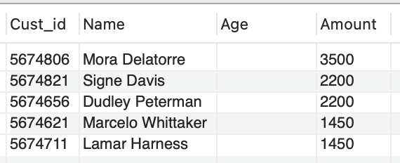
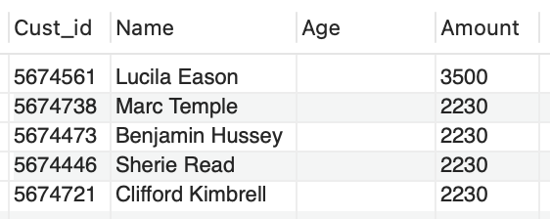
# QUERY_10 - FETCH DATA FOR TOP 10 CUSTOMERS WITH AGE GROUP AS A NULL VALUE FOR ONLINE CUSTOMERS ACCORDING TO DESC TOTAL AMOUNT SPENT SELECT Online_Order.Cust_id, Customer.Name, Customer.Age, Online_Order.Amount FROM Online_Order INNER JOIN Customer ON Online_Order.Cust_id = Customer.Cust_id WHERE Customer.Age = '' ORDER BY Online_Order.Amount DESC LIMIT 5;
# QUERY_11 - FETCH DATA FOR TOP 10 CUSTOMERS WITH AGE GROUP AS A NULL VALUE FOR RETAIL CUSTOMERS ACCORDING TO DESC TOTAL AMOUNT SPENT SELECT Retail_Order.Cust_id, Customer.Name, Customer.Age, Retail_Order.Amount FROM Retail_Order INNER JOIN Customer ON Retail_Order.Cust_id = Customer.Cust_id WHERE Customer.Age = '' ORDER BY Retail_Order.Amount DESC LIMIT 5;

